Slide 1
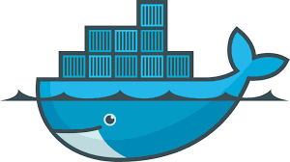
Docker session-2

Slide 2
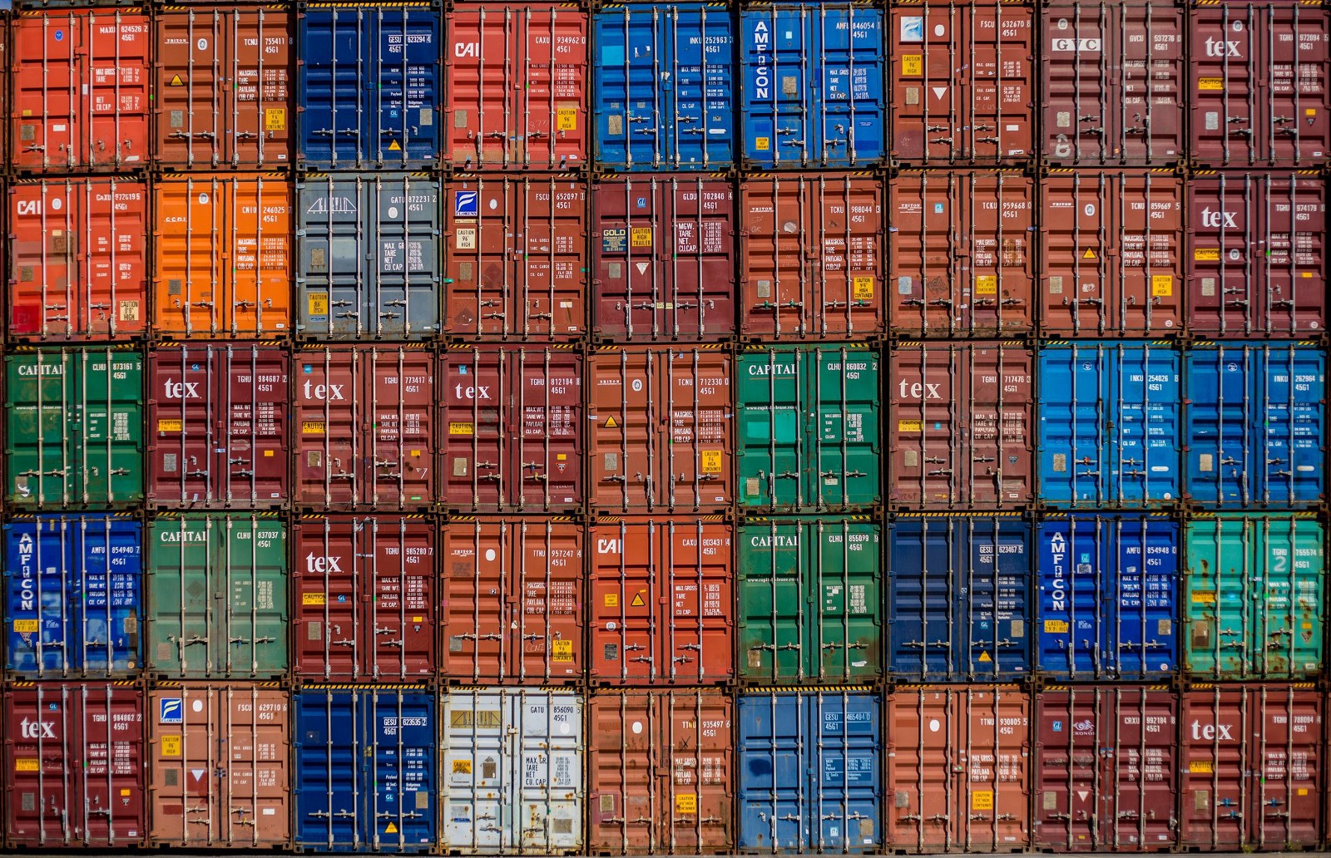

Slide 3
Own Registry
# docker run -d -p 5000:5000 --name localregistry registry
# docker tag busybox localhost:5000/busybox
# docker push localhost:5000/busybox

Slide 4
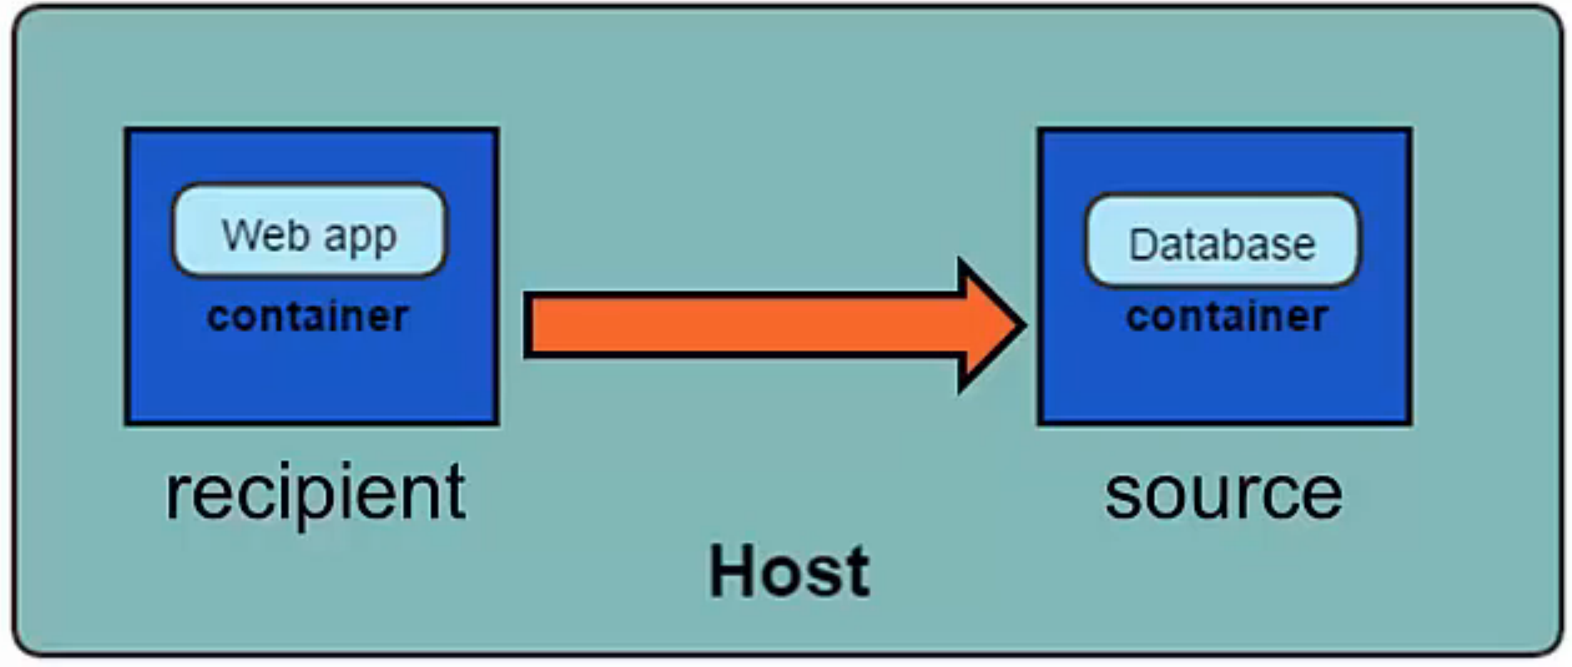
Linking Container

Slide 5
Linking
Linking is a communication method between containers which allows them to securely transfer data from one to another
Source and recipient containers
Recipient containers have access to data on source containers
Links are established based on container names

Slide 6
Linking
# docker run -d --name redis1 redis
# docker run -it --link redis1:redis --name client2 redis sh
redis-cli -h redis
# docker run -it --link redis1:redis --name redisclient1 busybox
Can connect the Same network bridge

Slide 7
Container Networking

Slide 8
Types of Network
None
container
Host
Overlay
bridge
-p <container port>
-p <host port>:<container Port>
-P expose all with host

Slide 9
None & container network
# docker run -d --net=none -p=9000:80 --name nginx_none nginx
# docker run -ti --net=container:nginx_none --name alpine alpine sh
# wget -O - localhost //not :9000

Slide 10
Host Network
Low latency protocol ( RTMP, Voip , Cache server )
Host network
# docker run –d –name voip –P --network host asterisk

Slide 11
Overlay network
Vxlan among the swarm servers.
# docker network create --driver overlay my-net

Slide 12
Bridge network
# docker network create --driver=bridge my-bridge

Slide 13
macvlan
# docker network create --driver macvlan --subnet 192.168.10.0/24 –gateway 192.168.10.1 –o parent=eth0 vlan.10

Slide 14
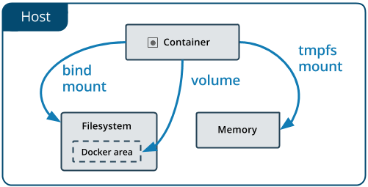
Docker Storage

Slide 15
Storage
Volume
Bind
TmpFS

Slide 16
Create the volume
# docker volume create <volumename>
# docker volume create my-vol
# docker volume inspect my-vol
# docker volume rm my-vol

Slide 17
Diff B/W volume and mount
-v or --volume
Copied data if already exisiting on the destination
--mount
Obscured the destination data

Slide 18
Docker volume
# docker volume create my-vol
# docker run -d -v my-vol:/usr/share/nginx/html:ro nginx
#docker service create --mount type=volume,src=my-vol,dest=/usr/share/nginx/html,readonly -d nginx

Slide 19
Docker bind
# docker run -v /app:/var/lib/app appimg:latest
# docker service create --mount type=bind,src=/app,dst=/var/lib/app –d appimg:latest
https://docs.docker.com/engine/admin/volumes/bind-mounts/#configure-bind-propagation

Slide 20
Docker tmpfs
# docker run -d –tmpfs /app nginx:latest
# docker service create --mount type=tmpfs,destination=/app –d nginx:latest
# docker inspect <containerID>
tmpfs-size
tmpfs-mode

Slide 21
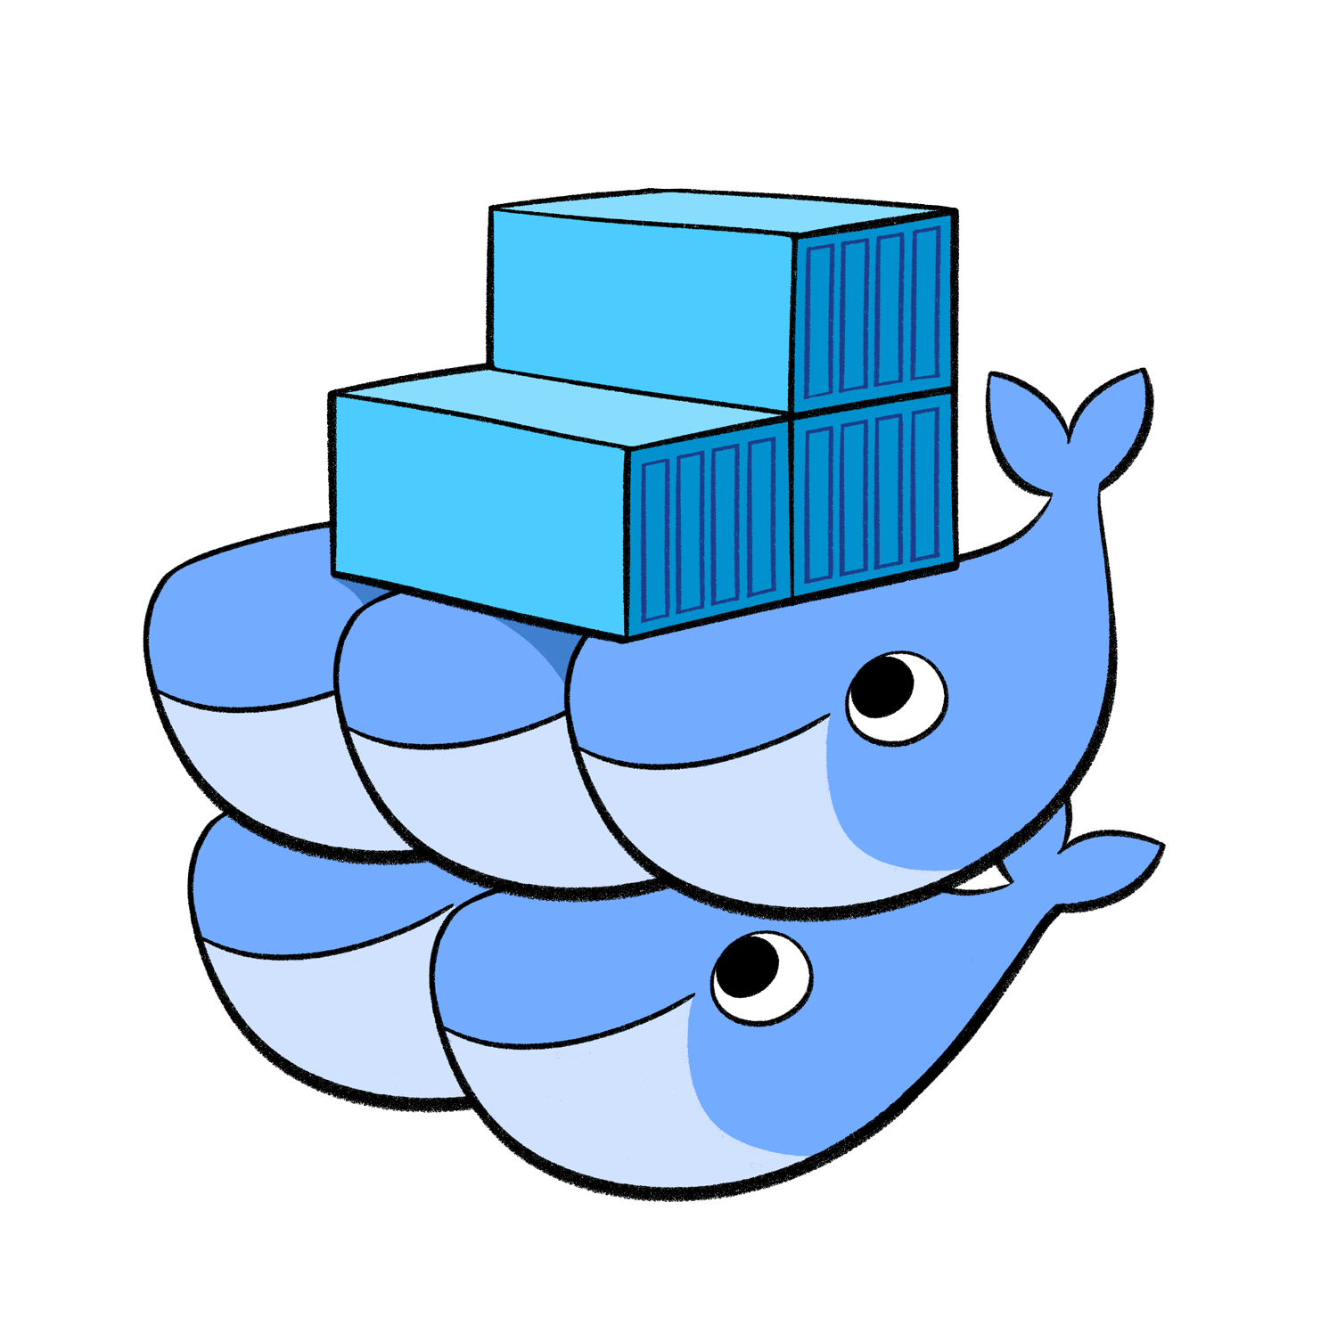
Swarm

Slide 22
SWARM
Cluster management integrated with Docker Engine:
Decentralized design
Declarative service model
Scaling
Desired state reconciliation
Multi-host networking
Service discovery
Load balancing
Secure by default
Rolling updates

Slide 23
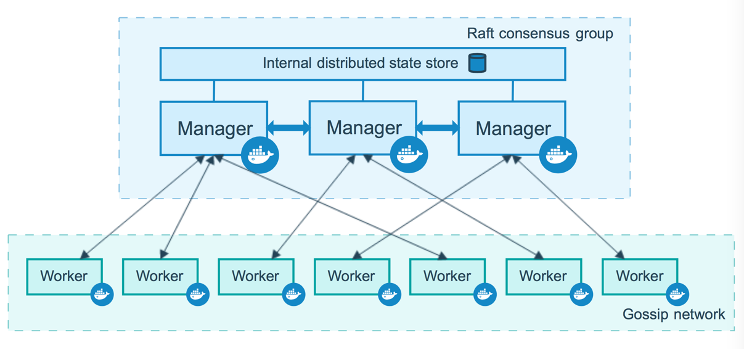
SWARM Archi

Slide 24
# docker swarm
Init:
--advertise-addr <IP>:<PORT> Default port 2377
--availability (“active”|”pause”|”drain”)
Join
--token < token>
Join-token

Slide 25
Remove from cluster
# docker node update –availability drain docker11.example.com
# docker ps -a <-- verify the running process
# docker node rm docker11.example.com ← Master
# docker swarm leave ← Client

Slide 26
Docker service
#docker service
Create
--replicas
--constraint
--placmenet-pref
--name
--network
--restart-condition (“none”|”on-failure”|”any”) (default “any”)
--restart-max-attempts
--mount type=local,src=/src,dst=/app

Slide 27
Docker service
# docker network create --driver overlay my-net
# docker volume create web-src <all swarm clusters>
# docker service create --name web --mount type=local,src=web-src,dst=/var/www/html --publish 80:80 --publish 443:443 --network my-net –replicas 3 --placement-pref ‘spread=node.lablels.rack’ --constraint ‘node.hostname == *.example.com’ -d
# docker service update --image web:latest --publish-add 8080:8080 web
# docker service rm web

Slide 28
# docker run -d --name database postgres
# docker run -d -P --name website --link database:db nginx
"db" is an alias added in /etc/hosts

Slide 29
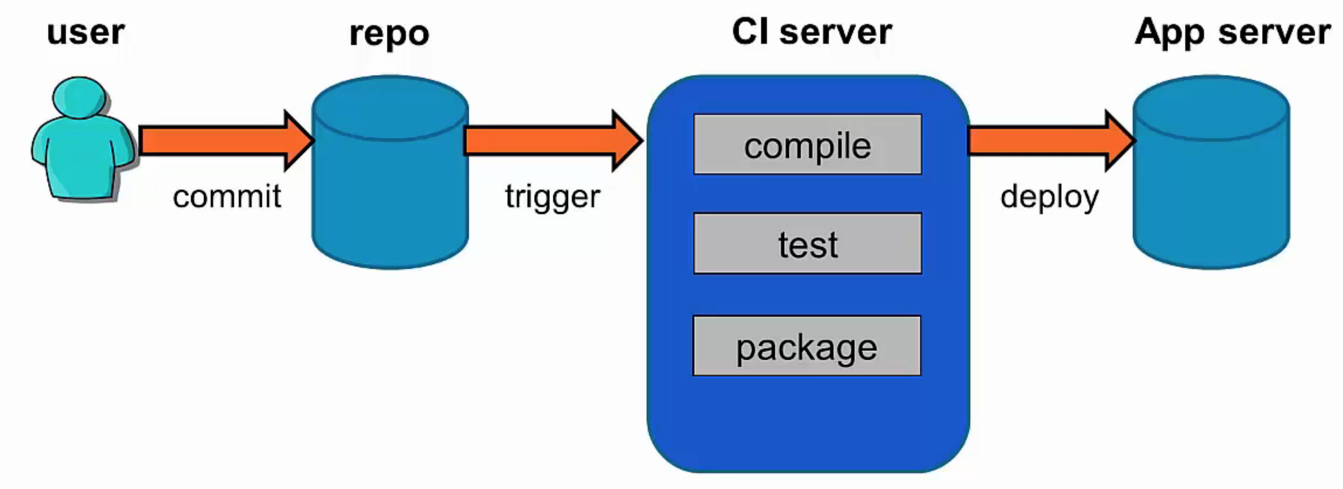
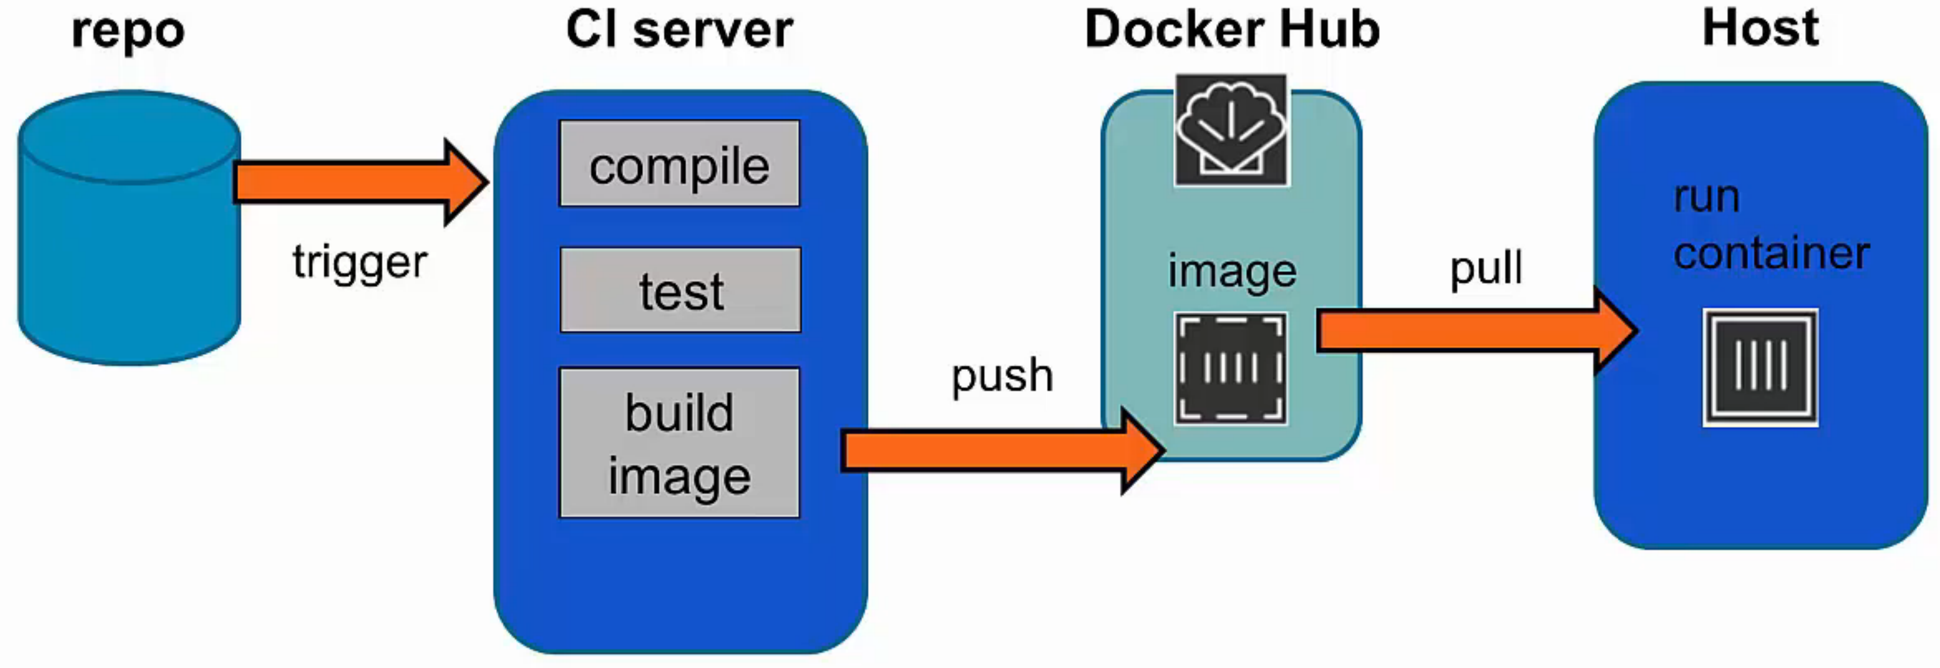
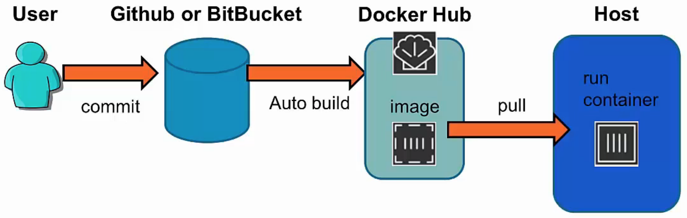
Docker in CI
traditional
Latest

Slide 30
Docker Compose
Docker Compose is a tool for creating and managing multi container applications
Containers are all defined in a single file called "docker-compose.yml”
Each container runs a particular component/service of your application. For example: Web front end / User authentification / Payments / Database
Container links are defined
Compose will spin up all your containers in a single command

Slide 31
Compose feature
Multiple isolated environments on a single host
Preserve volume data when containers are created
Only recreate containers that have changed
Variables and moving a composition between environments

Slide 32
3 step to create docker compose
Define your app’s environment with a Dockerfile so it can be reproduced anywhere.
Define the services that make up your app in docker-compose.yml so they can be run together in an isolated environment.
Lastly, run docker-compose up and Compose will start and run your entire app.

Slide 33
Docker-compose.yml
version: '2'
services:
javaclient:
build: .
command: java HelloWorld
links: - redis
redis:
image: redis

Slide 34
Installation
# curl -L https://github.com/docker/compose/releases/download/1.17.0/docker-compose-`uname -s`-`uname -m` -o /usr/local/bin/docker-compose
# chmod +x /usr/local/bin/docker-compose
# docker-compose --version

Slide 35
Running docker-compose
# docker-compose up
# docker-compose run
# docker-compose down [--volumes ]

Slide 36
Docker stack deploy
# docker stack deploy -c stack.yml wordpress
# docker stack rm wordpress
# docker stack ps
# docker stack serivce

Slide 37
PKI deployment
/etc/docker/daemon.json
{
"debug": true,
"tls": true,
"tlsverify": true,
"tlscacert": "/etc/docker/cert.d/ca-chain.cert.pem",
"tlscert": "/etc/docker/cert.d/docker60.example.com.cert.pem",
"tlskey": "/etc/docker/cert.d/docker60.example.com.key.pem",
"hosts": ["tcp://0.0.0.0:2376"]
}

